Slide 1



Rethinking Baseline Greenhouse Gas Emissions with Data Science

Slide 2


Goal
Can you estimate the energy use intensity (EUI) of these new buildings if they were to have existed back in 2006 using historical data from buildings?

Slide 3
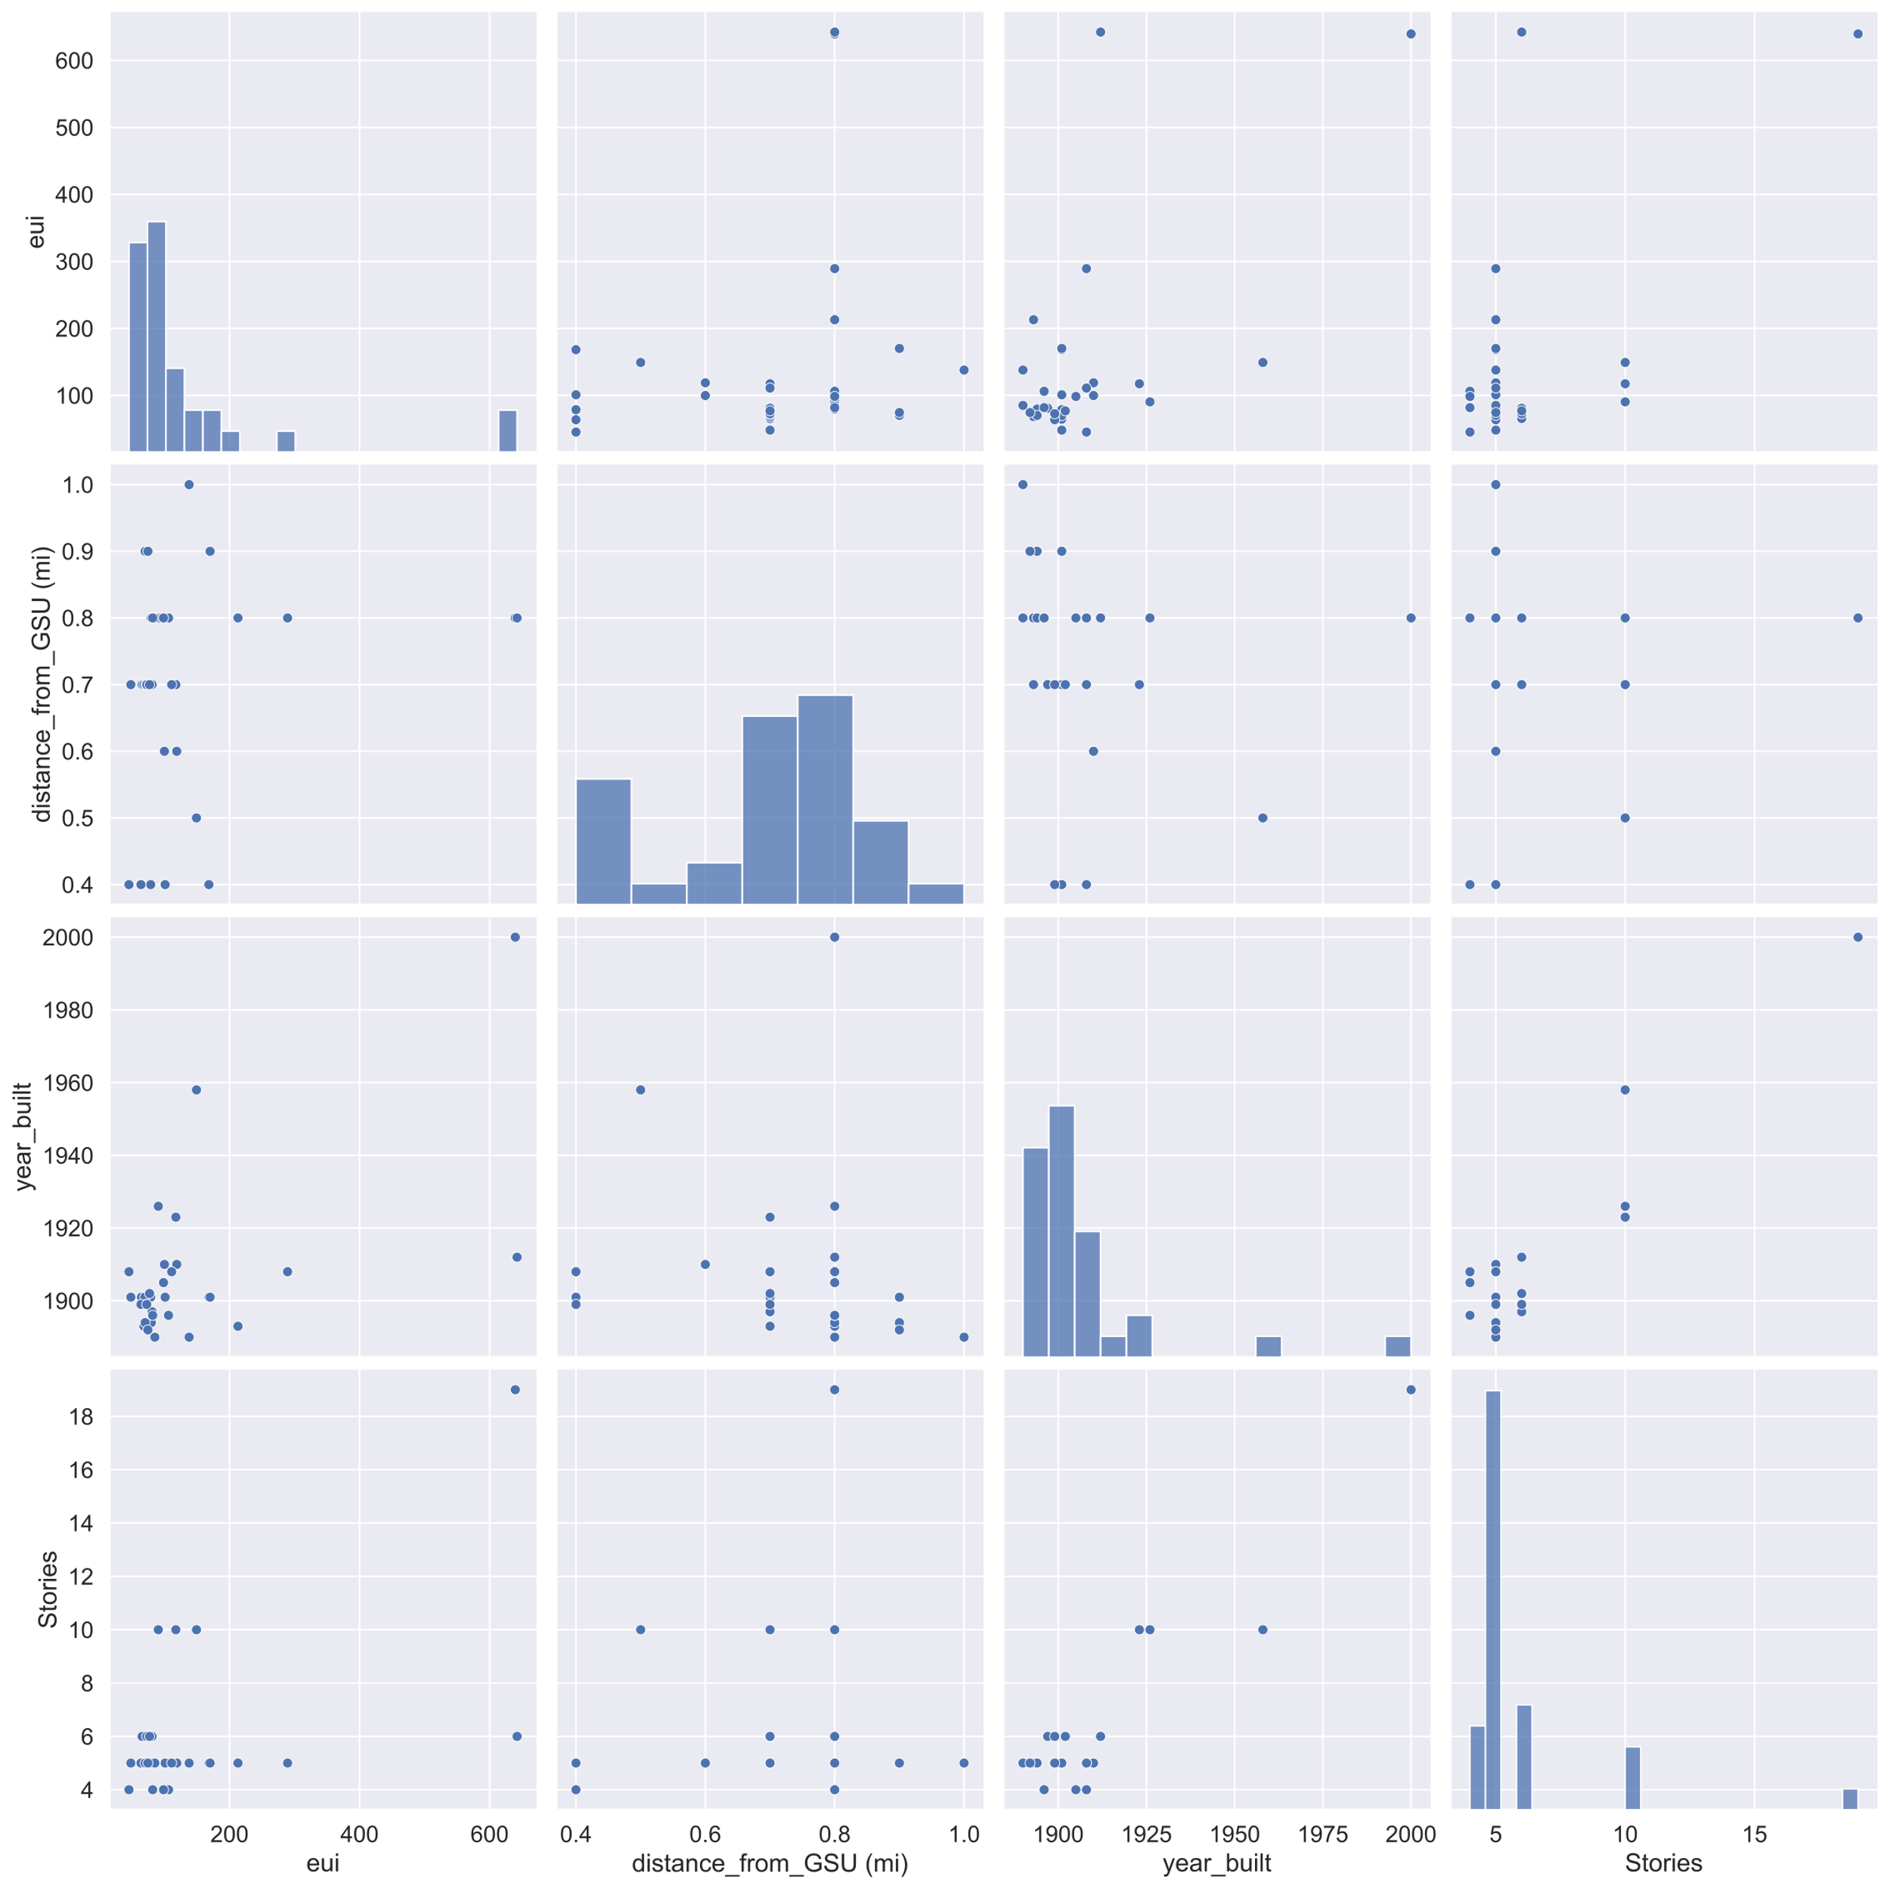
Data Exploration

Slide 4
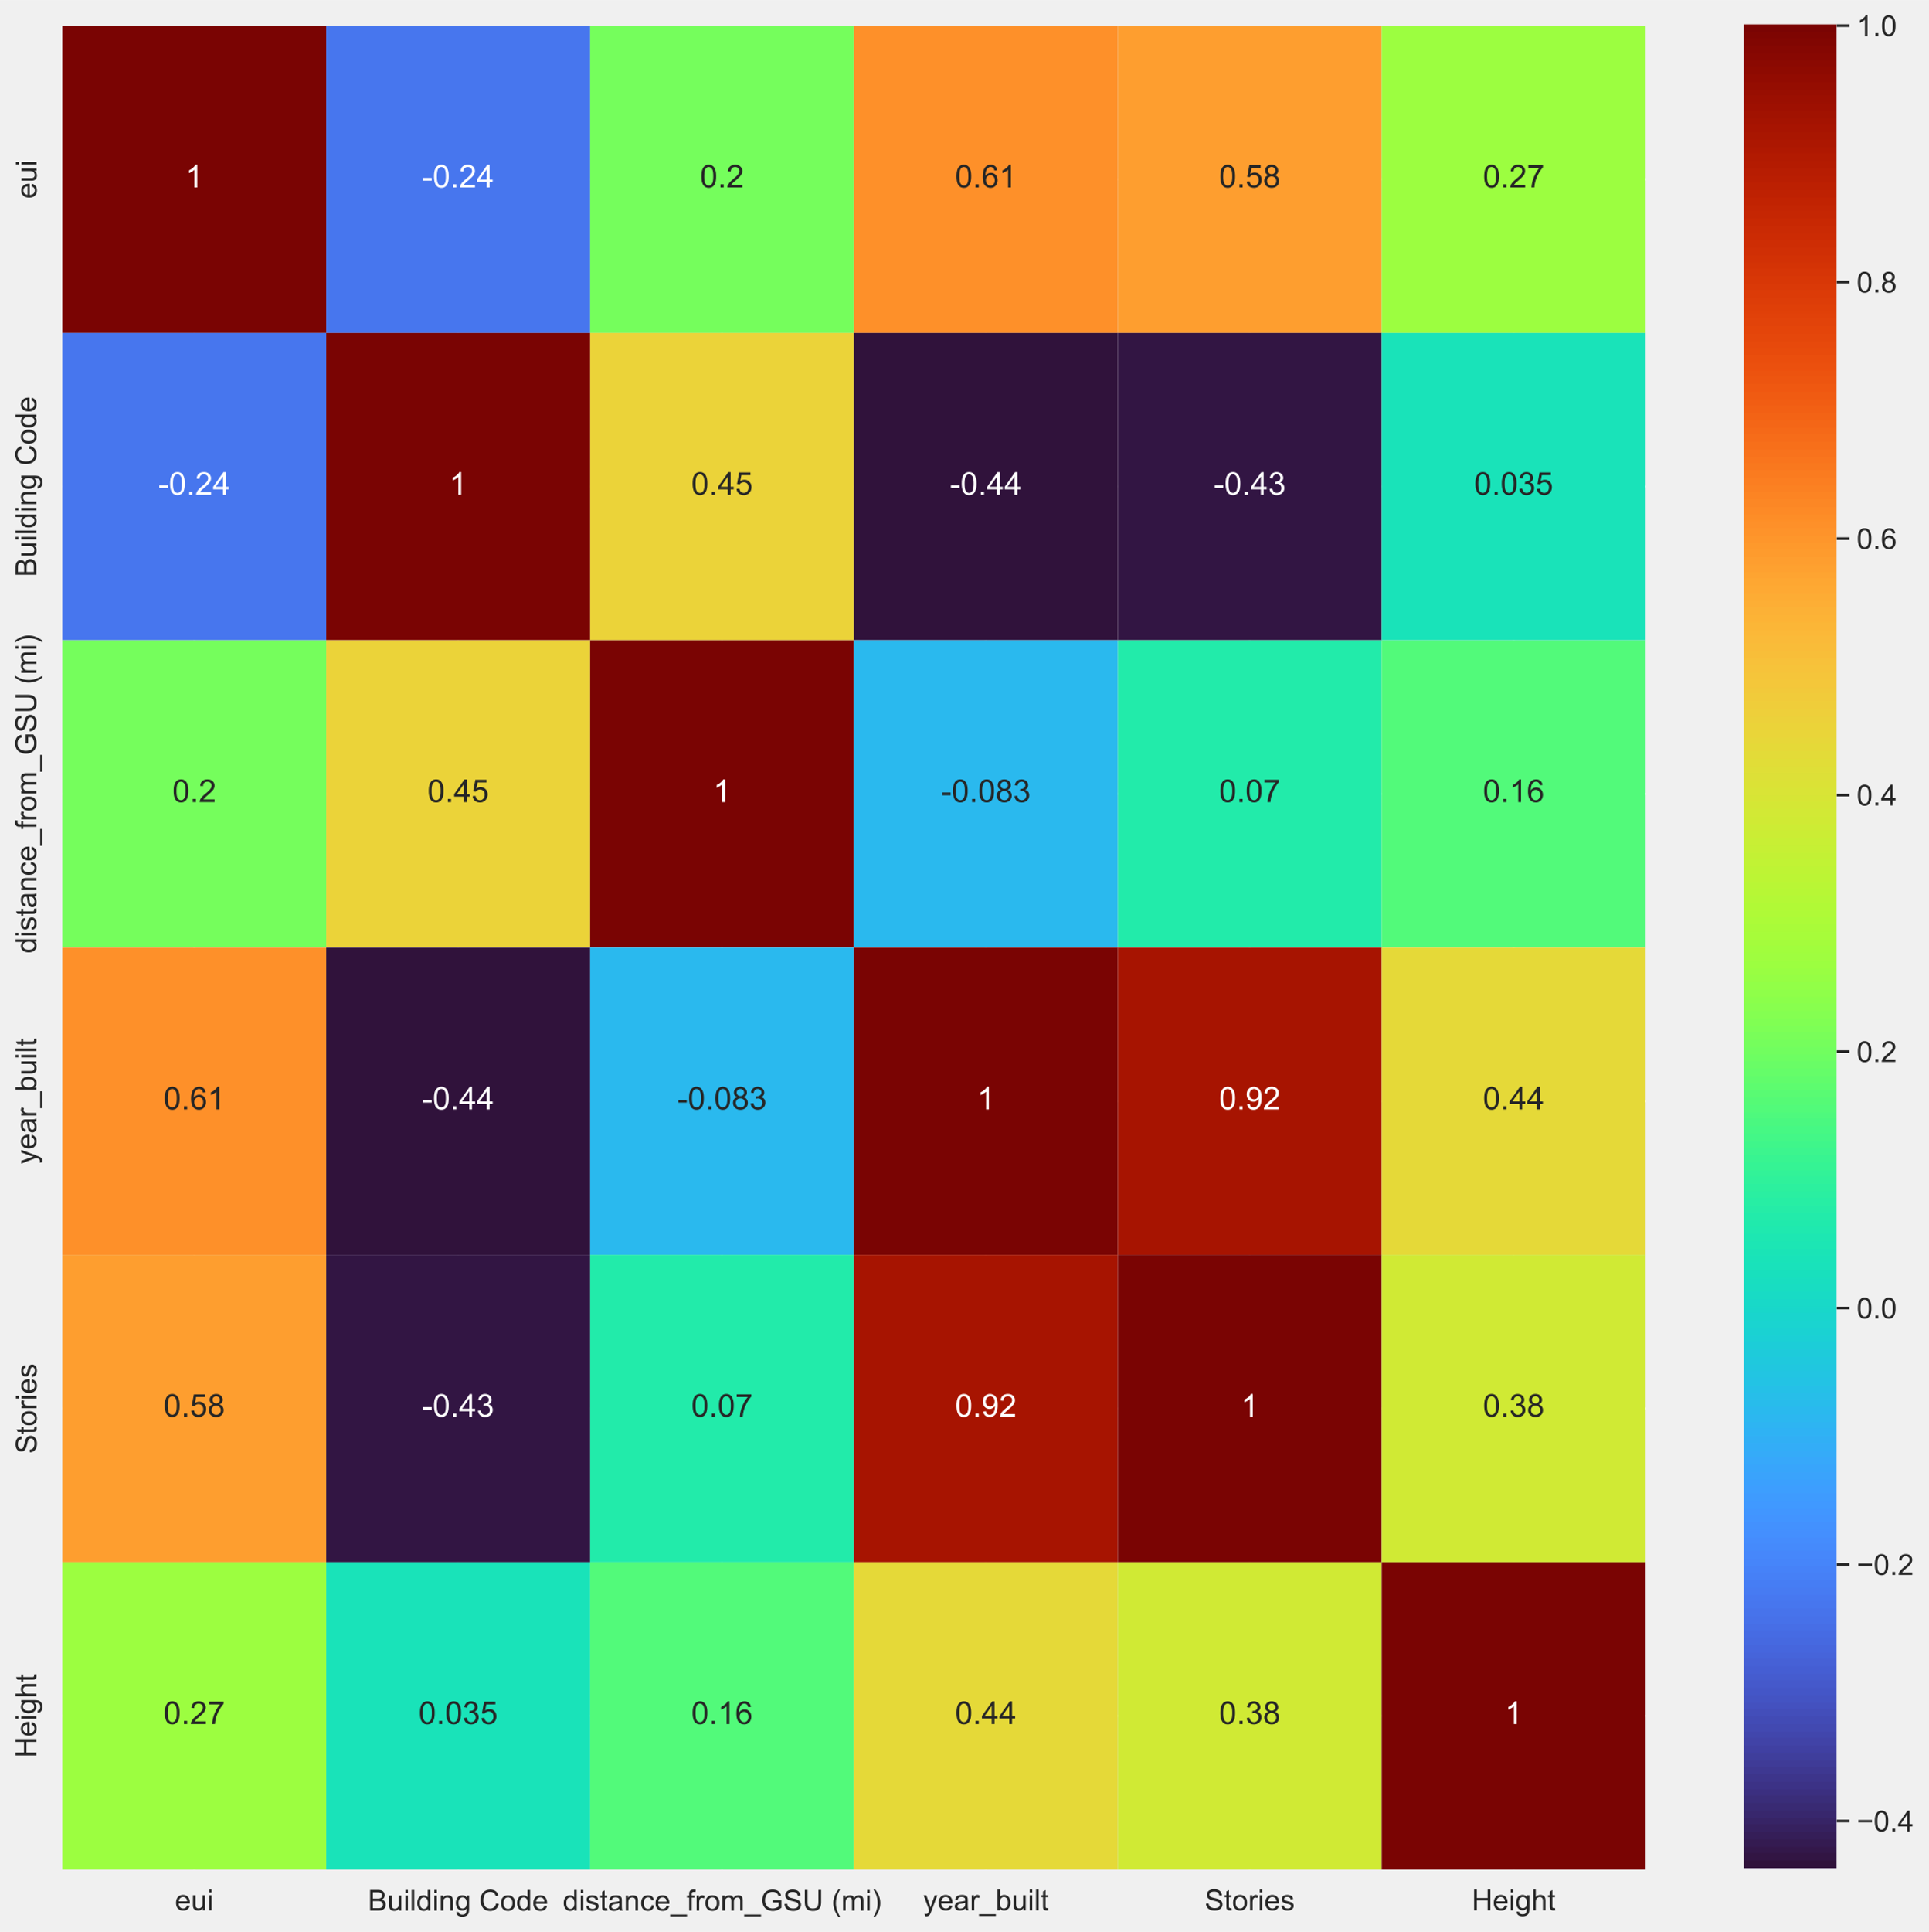
Pearson Correlations of Features with Energy Use Intensity (EUI)

Slide 5
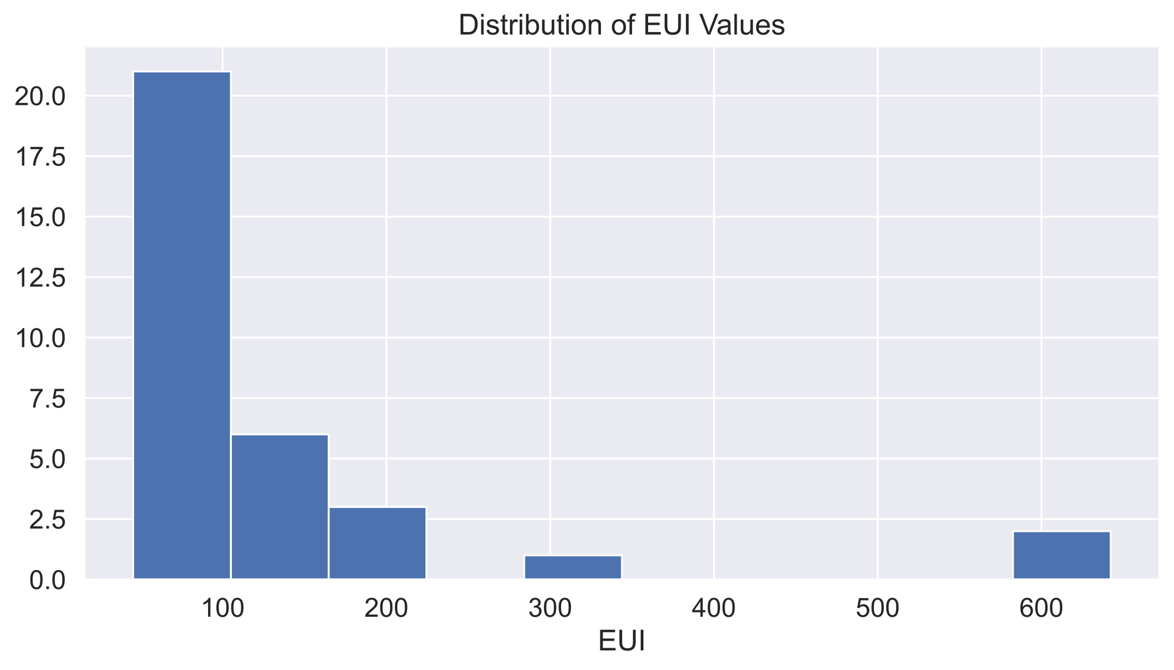
Observations
Location does not affect energy use intensity (EUI)
Year built and stories of a building are highly correlated with EUI
EUI values range from 45 to 650

Slide 6
Challenges
Small dataset (125 values after processing) and limited feature set
Some of energy, gas, and oil usages provided are 0
Assume that data is invalid
Extrapolating predictions to 2006

Slide 7
Modeling and Strategies
Simple Linear Regression
Benefits: fast and easy to interpret
Disadvantages: often unrealistic of real-world data with noise
Support Vector Regression
Benefits: shown to be very successful in practice
Disadvantages: can be computationally intensive and must search for optimal hyperparameters
K-Nearest Neighbors
Benefits: fast, easy to interpret, and no training process
Disadvantages: non-parametric algorithm (model grows with dataset size)

Slide 8
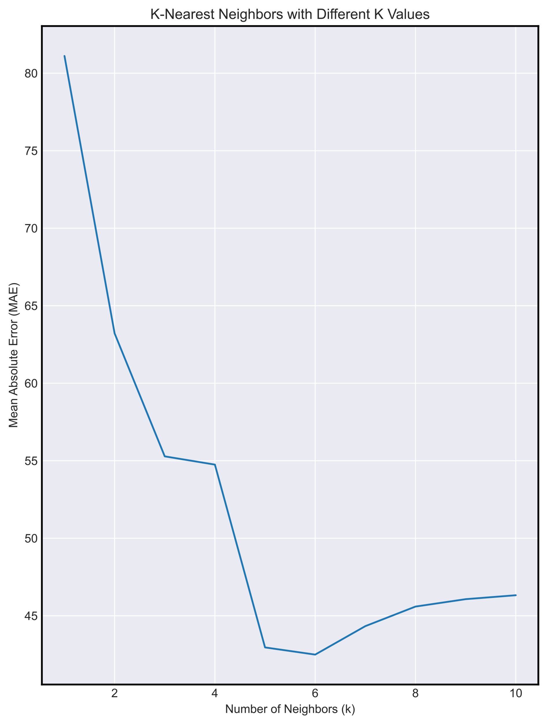
Results
Linear Regression performed best on individually predicting:
electricity use (kBtu)
gas use (kBtu)
natural oil use (kBtu)
Support Vector Regression performs well in predicting energy use intensity (EUI)
Validation MAE = 49.91
K-Nearest Neighbors performs best in predicting energy use intensity (EUI)
Validation MAE = 42.49

Slide 9
Takeaways
Promising performance for small subset of data and potentially erroneous samples
With more data and features algorithms such as gradient boosting (XGBoost) and Neural Networks can be explored

